Slide 1

Professor Karen Heard-Lauréote Dr Carina Buckley
Solent’s Learning Design Framework:
An active blended approach for an inclusive real-world curriculum
Notes:
KHL

Slide 2
How we teach at Solent
Notes:
KHL

Slide 3
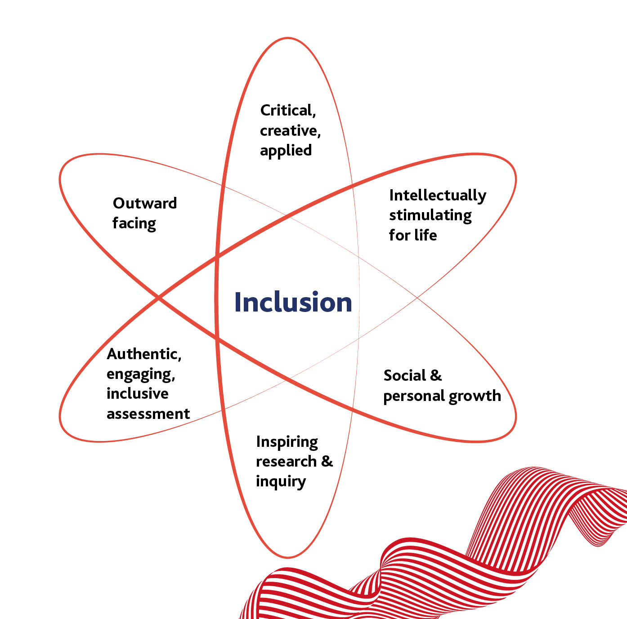
The Solent Curriculum
IRWC: Inclusive, real-world (practice-based) & research-led
Our UVP: We build students' and learners' confidence and help them make connections for our 3 readies: Work ready, World Ready, Future Ready
Notes:
We deliver teaching and learning through thoughtful integration of a combination of in-person delivery and delivery in a digitally enhanced, inclusive environment.
We believe an inclusive environment is a working, social and learning environment that intentionally promotes a culture of equality of opportunity and fair treatment; acknowledges, values, respects and celebrates difference; upholds and respects the dignity and rights of all staff, students and those connected with the University; one that actively strives to eliminate unlawful discrimination, harassment and victimisation and other uncivil conduct in order to enable everyone to reach their true potential.
Inclusion is an ethical obligation anchored in social justice and the building of socially just communities that promote equity for all groups irrespective of their intersecting identities and/or characteristics. This is reflected in educational policy, global agendas and contemporary discourse as essential in providing high quality educational experiences for all learners.
The concept of inclusion is at the heart of Solent’s Real-World curriculum framework. The framework is underpinned by pedagogic theories and consists of six dimensions.

Slide 4
Six curriculum dimensions
Creative, Critical & Applied
Inspiring Research & Inquiry
Outward Facing
Social & Personal Growth
Authentic, Engaging, Inclusive Assessment
Intellectually Stimulating for Life
Notes:
KHL
Real World Curriculum: Six Dimensions
Critical, creative and applied Our curriculum challenges students to be critical and creative, and to apply theory to practice. Through interaction with the global tapestry of knowledge systems, students will learn to identify the types of knowledge that exist, what informs their creation, and the extent to which various types of knowledge are related to each other.
We believe this will enable students to become perceptive consumers and trustworthy producers of both applied and theoretical knowledge that can be beneficial in transforming societies and producing real word solutions.
Inspiring research and inquiry Our curriculum will inspire students to ask questions, investigate problems, propose solutions and create new knowledge. We will empower students with the tools, methods and thinking processes to read and evaluate current research and stimulate curiosity about research topics of their choice. By working within a research community with academics who are engaged in research and inquiry and/or creative and applied projects themselves, our students will develop the requisite knowledge and skills to conduct their own research.
Outward facing As part of our social responsibility and contribution to social justice, our curriculum challenges students to contribute their knowledge, time and talents to the community in ways appropriate to their subjects. Students will engage with global theories, develop a global outlook, and interact with local and international experts as part of their overall student experience. Students will learn to work with industry professionals, and to link theory to practice in familiar and unfamiliar settings. We will encourage employers to shape the curriculum and help students create networks beyond the university.
Social and personal growth Our curriculum is designed to promote student’s development by enabling them to achieve social and personal growth. At Solent, students will engage with theory and a diverse range of knowledge to deepen their understanding of historic, contemporary, and future local, national, and international challenges and solutions. Through engagement in curricula and co-curricular activities, students will be supported to develop as emotionally and culturally intelligent socially responsible citizens who challenge taken-for-granted assumptions, speak out against injustices and actively contribute towards social transformation. This may enable students to become socially, culturally and emotionally intelligent graduates.
Authentic and engaging inclusive assessment Our assessments are inclusive and mirror disciplinary practices and real-world contexts in preparing students for the challenges of independent and team working, while enabling them to develop skills that will help them to succeed in the workplace. Students will experience a diverse range of creative, engaging and meaningful assessment tasks which will contribute to their development as critically conscious thinkers and life-long learners. Assessments will be scaffolded and grow in complexity, while enabling students to see the relationship between modules, years and stages if study.
Intellectually stimulating for life Our curriculum will trigger interest and inspire lifelong learning beyond university. They aim to develop curious habits of mind, transcend cross-disciplinary boundaries, and engage students in debates and conversations which extends beyond the university setting. We will inspire students to value learning for both their usefulness and their application, so that they will be able to see the relationship between knowledge (including theoretical and experiential knowledge) and their own development.

Slide 5
Blended Learning @ Solent University
Notes:
KHL

Slide 6

OfS Blended Learning Review 2022
Our individual institutional feedback:
Praised Solent’s central blended learning model, its objectives and the operational delivery model as clearly set out at a strategic level.
Praised the devolved decision making allowing the nuances of difference disciplines to be accounted for.
Students reported that they valued the choice and flexibility of Solent’s approach.
Following the publication of revised conditions of registration relating to the quality of courses which came into force on 1 May 2022, the OfS announced a review of blended learning in HE
In May 2022, Professor Susan Orr was appointed to lead the review. The OfS also appointed a panel of academic experts to explore different HE providers’ approaches to blended learning
The OfS published a response to the review panel’s report - extracts are published on these pages - summary and discussion of its themes.
Notes:
KHL
At Solent, we endeavour to create and sustain an equitable and inclusive educational environment that adopts a Learning Design Framework (LDF) which is underpinned strategically by our commitments to promoting creativity in the design, content and delivery of inclusive teaching, learning and assessment; embedding academic, digital and employability skills in the curriculum; and delivering relevant and engaging learning environments through high quality physical and virtual spaces, technologies and resources.
To offer a rounded, inclusive and flexible learning environment, we make full use of all the learning spaces available through these three concepts:
Collaborative Learning – 3 hour
Directed Learning – 1 hour
Guided Learning – 2 hour
Collaborative Learning takes place on campus and is active and interactive, providing opportunities for students to put their learning into practice and share their knowledge with their peers.
Directed Learning takes place mostly online, on-demand, and is focussed on the concepts and theories that underpin the subject. It is active and interactive, allowing students to engage with the material, the lecturer, and each other, and it is structured and consolidated through a narrative that explains how everything fits together.
Guided Learning adds value to students. In many ways, it's all the things we put on for students alongside the course and their studies that we would like them to engage in and we know would be good for them but which they do not necessarily take up. Guided Learning will enable us to ensure visible value for money by getting a greater proportion of our students to engage in activities that build their employability and self-efficacy.

Slide 7
Spotlight on our Learning Design Framework
Notes:
KHL

Slide 8
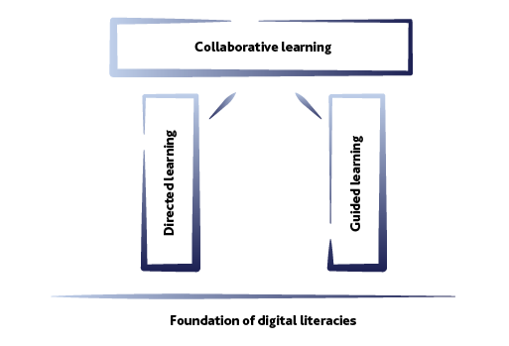
The Learning Design Framework
Active and participative
Extension beyond the classroom
Broadening the curriculum
Future facing
Notes:
KHL
At Solent, we endeavour to create and sustain an equitable and inclusive educational environment that adopts a Learning Design Framework (LDF) which is underpinned strategically by our commitments to promoting creativity in the design, content and delivery of inclusive teaching, learning and assessment; embedding academic, digital and employability skills in the curriculum; and delivering relevant and engaging learning environments through high quality physical and virtual spaces, technologies and resources.
To offer a rounded, inclusive and flexible learning environment, we make full use of all the learning spaces available through these three concepts:
Collaborative Learning – 3 hour
Directed Learning – 1 hour
Guided Learning – 2 hour
Collaborative Learning takes place on campus and is active and interactive, providing opportunities for students to put their learning into practice and share their knowledge with their peers.
Directed Learning takes place mostly online, on-demand, and is focussed on the concepts and theories that underpin the subject. It is active and interactive, allowing students to engage with the material, the lecturer, and each other, and it is structured and consolidated through a narrative that explains how everything fits together.
Guided Learning adds value to students. In many ways, it's all the things we put on for students alongside the course and their studies that we would like them to engage in and we know would be good for them but which they do not necessarily take up. Guided Learning will enable us to ensure visible value for money by getting a greater proportion of our students to engage in activities that build their employability and self-efficacy.

Slide 9
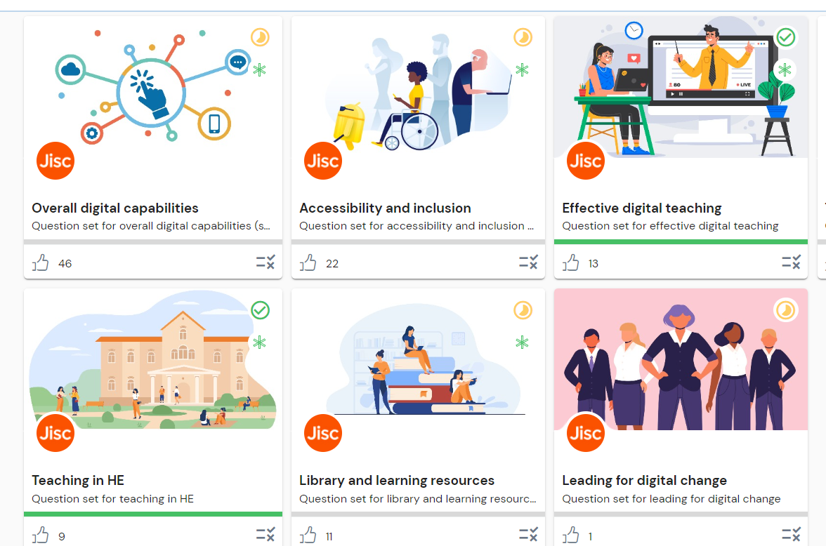
Underpinning of Digital Literacies
Staff, students & learners should feel confident and effective in accessing and using digital tools, maximising their affordances and creating new knowledge and artefacts
Notes:
CB
Links back to GL offer

Slide 10
The LDF in brief
Collaborative Learning – the keystone.
Takes place on campus and is active and interactive, providing opportunities for students to put their learning into practice and share their knowledge with their peers.
Directed Learning
takes place in SOL, our VLE, on-demand; focused on the concepts and theories that underpin the subject. It is active and interactive, allowing students/learners to engage asynchronously with the material, the lecturer and each other, and it is structured and consolidated as a learning journey that explains how everything fits together.
Guided Learning
adds value to students/learners; all the things we put on for students alongside the course and their studies we would like them to engage in and we know would be good for them but which they do not necessarily take up. Enables us to ensure visible value for money by getting a greater proportion of our students to engage in activities that build their employability and self-efficacy.
All underpinned by a foundation of Digital Literacies
Notes:
KHL

Slide 11

Collaborative Learning
On campus
Active and interactive
Students/learners have the opportunity to:
Put their learning into practice
Learn from each other
Share their knowledge
The keystone of our L&T experience
Notes:
CB

Slide 12

Collaborative Learning
Pedagogy: active learning
Learner-centred
Interactions-based
Sense-making activities
Effective learning happens in situated contexts, which combine physical, mental, emotional and social processes
Notes:
CB

Slide 13
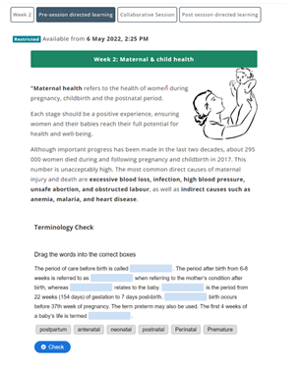
Directed Learning
In SOL, our VLE
On demand
Participative
Can be pre OR post CL events
Supports and scaffolds student autonomy
Consolidates key concepts and theories
Students and learners guided through the content by the tutor's scaffolding
Notes:
CB

Slide 14
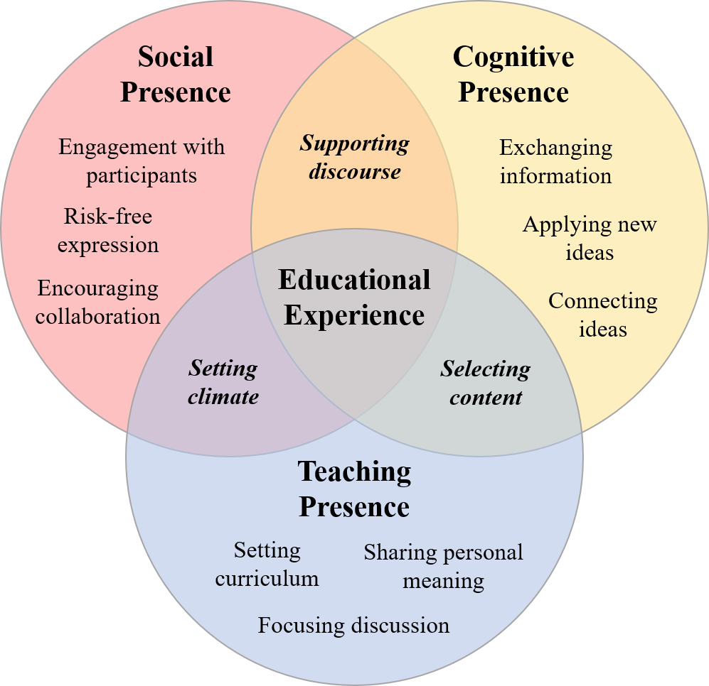
Directed Learning
Pedagogy: the Community of Inquiry Framework
In a social constructivist learning environment, the role of the teacher changes from holder of knowledge to facilitator of understanding
https://coi.athabascau.ca/coi-model/
Notes:
CB

Slide 15
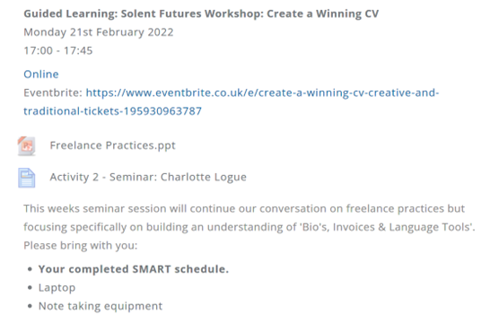
Guided Learning
Central support services led GL: Centralised offer
Course-led GL: Curriculum-based
Adds value to the student learning experience
Development and enhancement of skills, knowledge and attributes
Focused employability, self-efficacy and career progression
Notes:
CB

Slide 16

Guided Learning
Pedagogy
Tinto’s (1997) Interactionist model of student persistence
A function of pre-entry attributes, goal commitments, effort, academic integration, social integration and institutional experiences
Notes:
CB

Slide 17
Spotlight on Guided Learning
Notes:
KHL

Slide 18
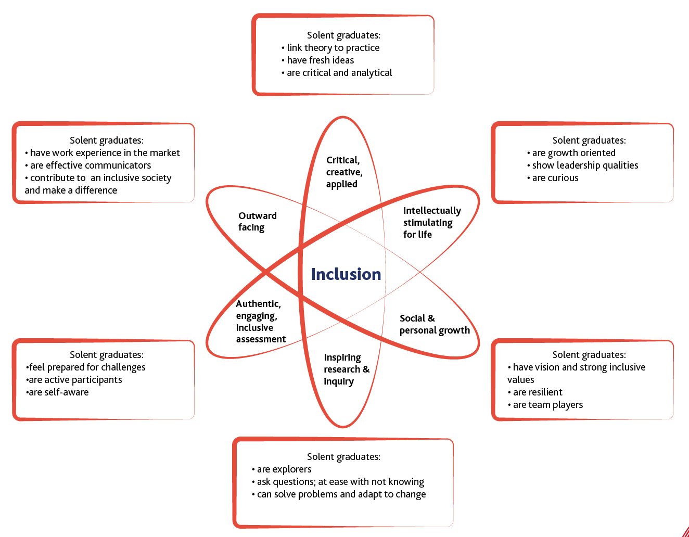
The Solent Curriculum (2)
Employability & Enterprise are fully embedded in the curriculum all working towards graduate attributes.
Notes:
KHL

Slide 19
GL & TEF Educational Gains
Built around a Solent University specific scaffolded learner journey approach with thematic focus at each level of study:
Level of Study | Theme | Aim
Level 3 | Building Confidence PLUS | Build a foundation of confidence to hit the ground running in Level 4
Level 4 | Building Confidence | Levelling up to build student/learner confidence ready for success at University
Level 5 | Making Connections | Deploy Group Inter-Level Peer-Led Coaching as a mechanism to raise Level 5 student/learner aspirations to successfully transition to Level 6 (Level 6, Level 7 and PGRSs coach Level 5 students)
Level 6 | Building professional Networks | Support students/learners to build and expand their professional networks preparing them for employment/the future
Level 7 | Building Professional Networks PLUS | Extending students' professional networks further
Notes:
KHL

Slide 20
Examples of Course-Led Guided Learning
A unique and distinctive values proposition
Visit to a local industry partner/employer
External speaker – guest keynote (could be online to minimise costs)
Course alumni panel
Lab time where students are using facilities and staff may be around but not "teaching"
Rehearsals
Screening
IT Workshop
Equipment Induction
Tutorial
Notes:
Allows us to develop a unique values proposition around what we offer at Solent which is distinctive from other providers
It's anything else that we offer to students beyond the core L&T delivery of the subject-area
It's the cherry on the cake – it's going the extra mile
Reputationally it links to what we have said in our TEF and what we will say in our Access and Participation Plan about the educational gain derived from studying at Solent University beyond the core subject-specific curriculum
Plus a properly curated, simplified and streamlined offer of professional-services led GL so that course teams know what to signpost their students to

Slide 21
Operationalising the LDF
Theory to practice!
Notes:
KHL

Slide 22
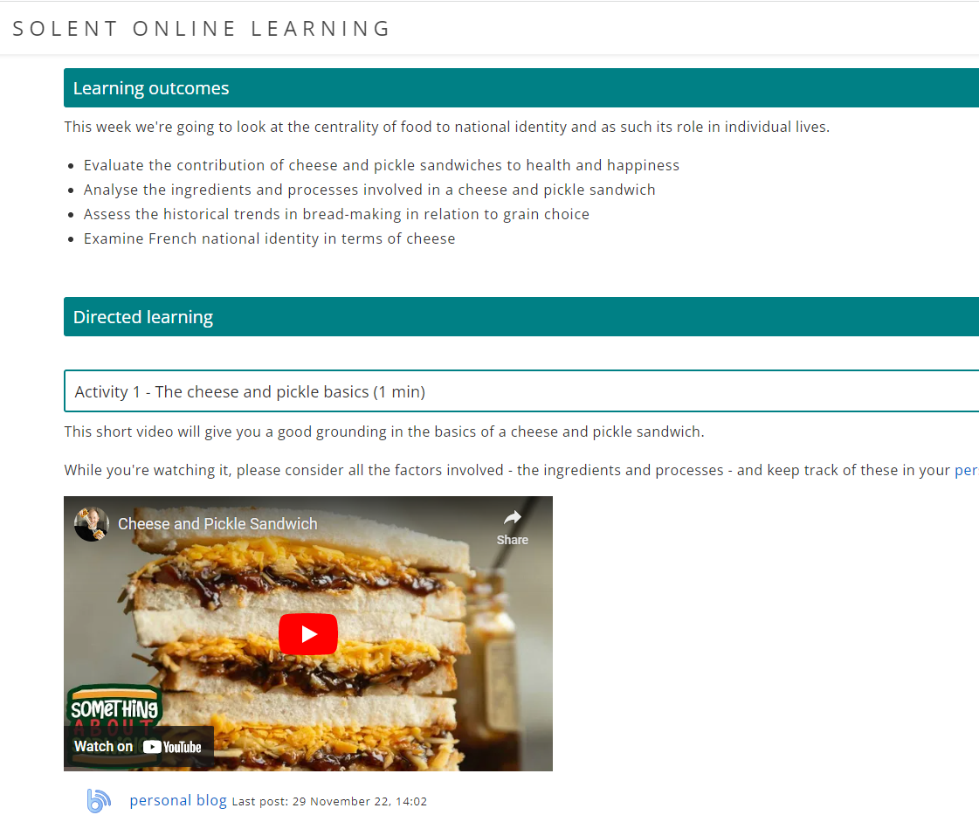
1-2-3+ implementation
Per week, per module:
1 hour of Directed Learning (pre OR post CL events)
2 hours of Collaborative Learning
At least 3 hours of Guided learning

Slide 23
1, 2, 3+
What it means for staff and students
Student Facing
In HE we talk about "Notional Hours" per credit
For example, 20 credit modules = 200 notional hours
A 360 credit degree = 3600 notional hours
Contact hours is the proportion of notional hours spent with staff (academic and non-academic)
Non-contact hours is time students spend in independent study: reading, revising, preparing for assessments etc.
In this approach we are not reducing contact hours – we are increasing student/learner contact points with learning opportunities
Staff Facing
Planera = records Academic delivery hours
For space rationalisation and optimisation and to free up more time for the other dimensions of academic life: research & scholarship we are looking for a ratio of 2.1 hours per credit
2.1 x 20 credits = 42 hours of academic delivery
Leaving 158 hours (13 hours a week) of student Independent Study - in the library or other learning spaces or as much Guided Learning as we can signpost students to
Notes:
KHL

Slide 24
1, 2, 3+
GL - Where does this 3+ hours of GL per week come from?
There are two types of GL: Course-led GL (Academic Community) Central Support Services-led GL (Support Community)
6 hours (at least – could be more!) for each Module over the semester = Course-led GL
But because GL is best delivered at Course Level – we suggest combining GL hours across Modules per Level of Study: For example, 1st Semester of L4 = 3 x 20 credit modules = 18 hours in total of GL
Surfacing GL at Course Level on Course SOL page: Enhances learning community, sense of course belonging, large cohort feel etc. And drives students to engage with SOL Course page
Much more Central Support Services-led GL can be offered and signposted (Library to be coordinating point).
123+
We are looking for a model of DL, CL & GL aligned to 123+ per week based on 12 teaching weeks
1 hour of DL per week = 12 hours On demand in SOL, our VLE
2 hours of CL per week = 24 hours Active, participative classroom based
After accounting for 36 hours of DL and CL: There are 6 hours remaining to get to 42 hours (based on 2.1 hrs per credit)
Based on a 12 week teaching week we are looking for at least 3 hours of GL per week = 36 hours+ of GL
Notes:
KHL

Slide 25
How this translates to Planera
NEW NAME | Contact Type
Directed Learning | AcademicDelivery
Collaborative Learning | AcademicDelivery
Collaborative Learning IT - Academic | AcademicDelivery
Guided Learning IT - Workshop | GuidedLearning
Collaborative Learning - Practical/Academic | AcademicDelivery
Guided Learning Workshop - Practical Workshop or Lab | GuidedLearning
Guided Learning - Presentation | AcademicDelivery
Collaborative Learning - Presentation/Assessed | AcademicDelivery
Guided Learning - External Visit | AcademicDelivery
Guided Learning - Screening | GuidedLearning
Maritime-SQA
Maritime-Oral
Maritime-IAMI
Guided Learning - Tutorial/Drop In (On Site) | DropInTutorial
Equipment Induction | GuidedLearning
Notes:
KHL

Slide 26
Questions, discussion...
Notes:
KHL & CB

